Slide 1
Brain Scan Classification:
Technology Review Presentation
Authors: Alyson Suchodolski, Sabrina Wang, Trevor Nims, Vanessa Hsu, Aaliyah Fiala, Jordan Fields
Date: 2/23/2021
Notes:
Trevor

Slide 2
Problem Background
Since their advent in the 1970s, MRI imaging techniques have been used to detect health problems and confirm diagnoses in patients where a simple physical examination is insufficient. However, despite the power of these machines oftentimes an expert physician is needed to look over the images to detect more nuanced types of conditions.
Using the 2015 BraTS (Brain Tumor Segmentation) data set, we plan on creating a model able to classify brain tumors into two groups:
High Grade Glioma (HGG): Highly malignant and difficult to treat
Low Grade Glioma (LGG): More slow moving - responds better to treatment
Notes:
Trevor

Slide 3
Development Stages for Classification Model
Split the data into test and train datasets and designate the predictor and response variables
Data Setup
Train Model
Iterate each image in the training set to create the brain scan classification model
Test Model
Check accuracy of model by comparing with test dataset
Notes:
Aaliyah

Slide 4
PyTorch vs Tensorflow
Pytorch
A free and open source machine learning library developed by Facebook’s AI Research Lab
MedicalTorch: medical imaging analysis tool built into PyTorch
More tightly integrated with the Python language and have more access to the code
Tensorflow
A free and open source software library for machine learning developed by Google
The framework is well-documented and has many official tutorials for medical image analysis
Tensorboard makes creating visualizations for model performance easier
Keras API offers ready-made building blocks that are easy for newcomers to understand
Notes:
Vanessa

Slide 5
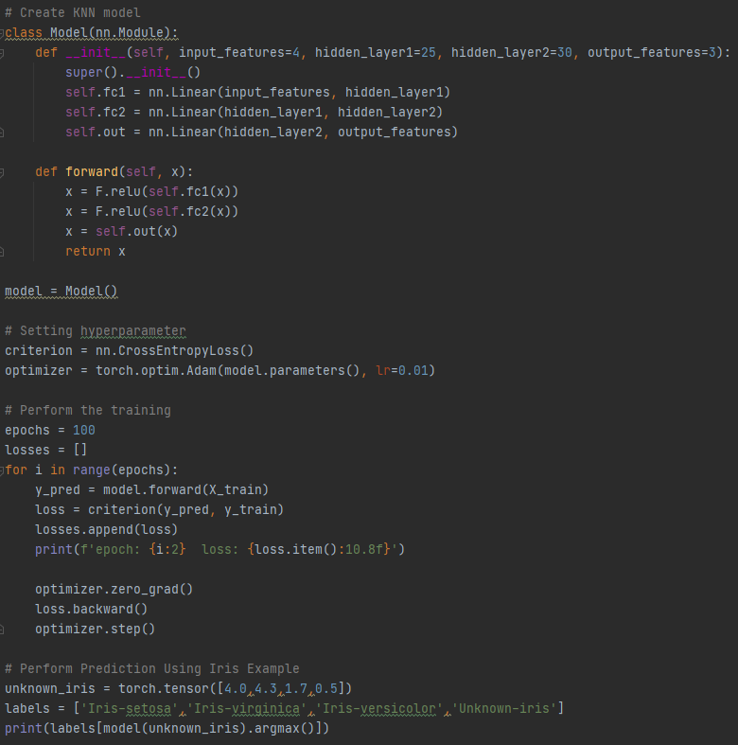
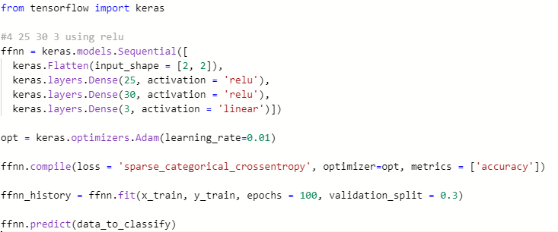
Initializing a feedforward network model
Pytorch vs Tensorflow
Notes:
Jordan

Slide 6
PyTorch vs Tensorflow
Github Count | PyTorch | Tensorflow
Stargazers | 46.2k | 153k
Forks | 12.3k | 84k
Total Issues | 5k+ | 3.8k
Open Issues | 5,623 | 3,786
Notes:
Sabrina

Slide 7
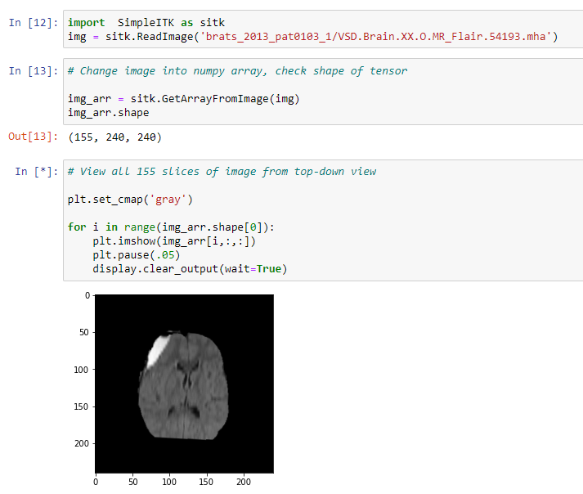
SimpleITK
We will be using the SimpleITK Python Package to view the multidimensional MRI (.mha) files as an array of images that are easily accessible
It can be used for filtration, registration, and image segmentation
.mha files are related to MetaImage, a text-based tagged file format for medical images, and are directly related to ITK (Insight Segmentation and Registration Toolkit)
Demo
Notes:
Alyson’s Slide

Slide 8
Cited Sources
PyTorch vs TensorFlow — spotting the difference: https://towardsdatascience.com/pytorch-vs-tensorflow-spotting-the-difference-25c75777377b
SimpleITK
https://simpleitk.readthedocs.io/en/master/gettingStarted.html#python-binary-files

Slide 9
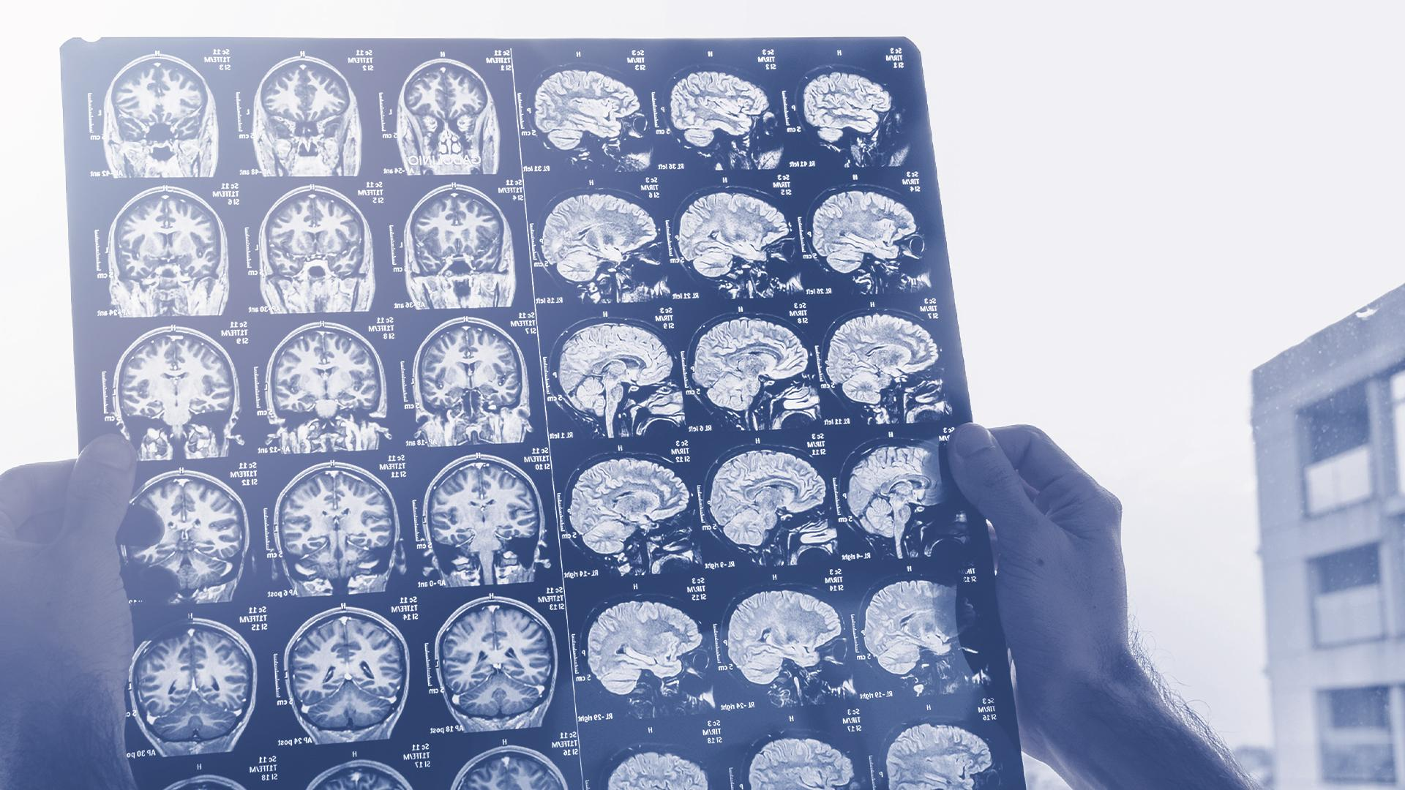
THANKS!

